Slide 1
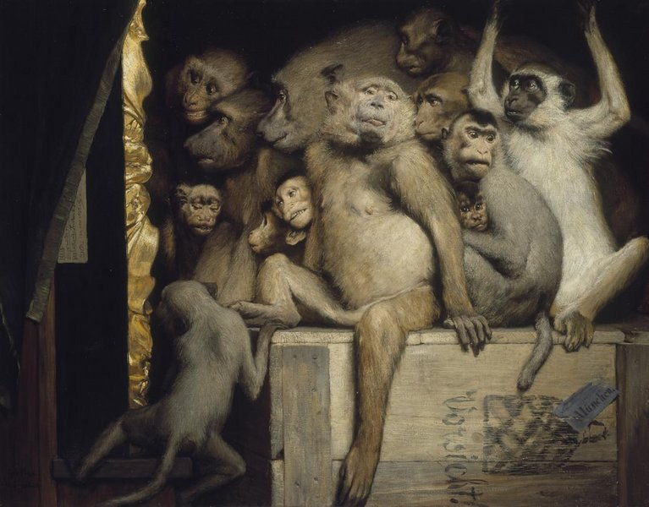
Section 7
Clustering
slides credit: 2021Sp Staff

Slide 2
Administrivia
Homework 5 released, due this Tuesday (11/14)
Learning reflection 5 due tomorrow @ 9pm (Fri, 11/10)
Next week: PCA / Recommender Systems

Slide 3
Clustering
Unsupervised form of learning (no labeled data!)
Makes use of embedding and distance
Embedding: Turning data into a vector of continuous numbers
Distance: Measurement of how far apart two data points are
Putting data points into discrete groups or “clusters” based on a distance metric

Slide 4
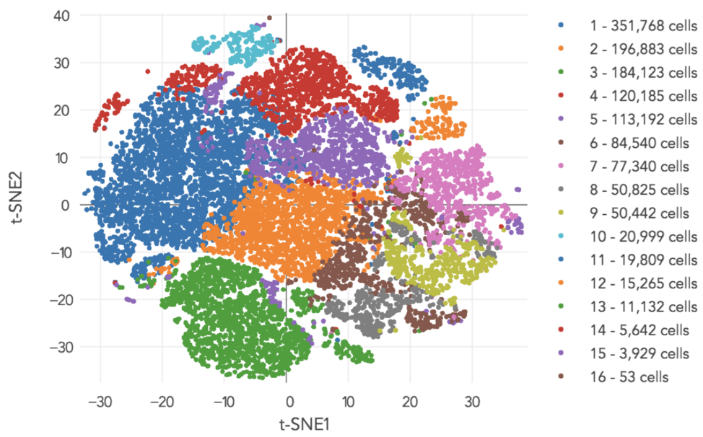
Example
Clustering human cells based on gene expression data
link to source

Slide 5
K-means clustering
Big idea: Iteratively divide the data up into K groups of equal variance
Step 1: Assign each data point to the closest of K centroids
Step 2: Move each centroid to the mean position of the data assigned to it
Repeat until convergence!

Slide 6
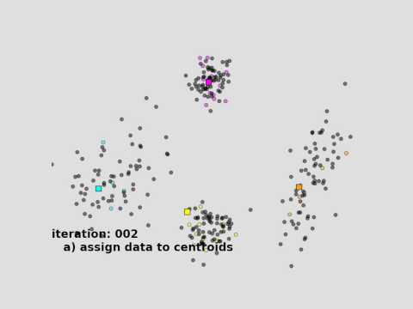

Slide 7
Initializing Centroids
Easy method: Random initial centroids
Could get stuck in a bad local optima!
Smarter (but harder) method: Place centroids far away from each other
P(centroid placed at x_{i}) ∝ distance to nearest centroid

Slide 8
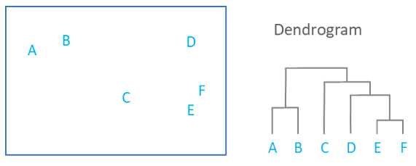
Hierarchical Clustering
Spherical clusters may not accurately describe the underlying structure of the data...
Hierarchical clustering learns more flexible cluster shapes by linking smaller clusters together (agglomerative) or dividing larger clusters (divisive)
No need to choose “K” beforehand
Can use distance metrics other than Euclidean

Slide 9
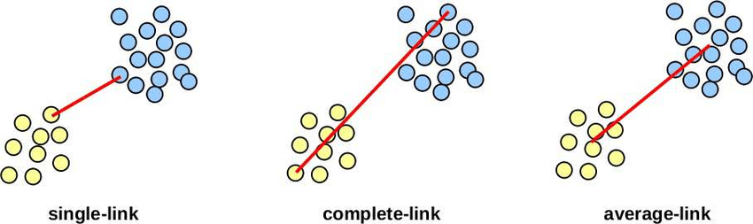
Agglomerative Clustering
Start with every data point in its own cluster
Iteratively combine the two closest clusters into one
Different metrics of distance between clusters
Single linkage: Minimum distance between points in the two clusters
Complete linkage: Maximum distance between points in the two clusters
Centroid linkage: Distance between mean points in the two clusters

Slide 10
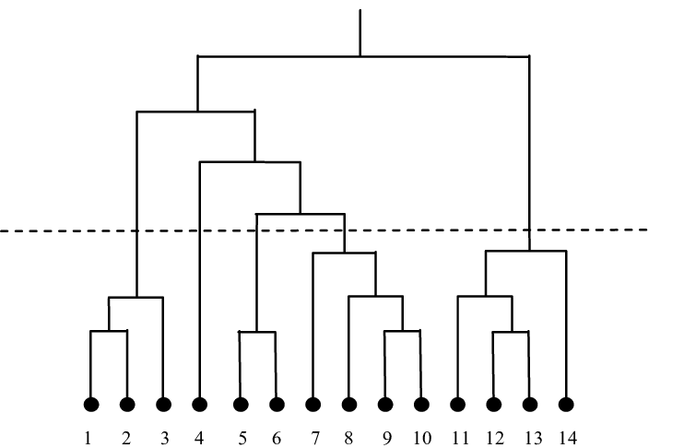
Agglomerative Clustering
Build up a dendrogram representing which clusters combined and when
“Cut” dendrogram at a certain height to get desired number of clusters
5 clusters

Slide 11
Practice Questions
1. Which has better computational complexity?
2. Which has more hyperparameters?
K-means or Agglomerative Clustering
Notes:
Answers: 1) K-means but an argument could be made that they are the same (best agg. Clustering is O(n^2))
2) Open-ended (K-means has K, initialization strategy, possibly # iterations. Agg. has distance metric, linkage type, cluster threshold)

Slide 12
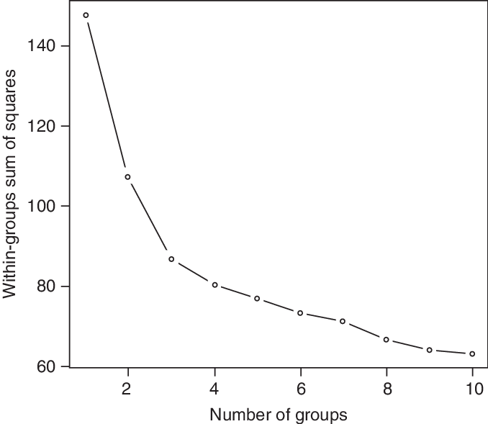
Practice Questions
Based on the graph, what number of clusters (K) is most optimal?
Notes:
Answer: 3

Slide 13

Practice Questions
Based on the graph, what number of clusters (K) is most optimal?
Hint:
Notes:
Answer: 3

Slide 14
NumPy Overview
Efficient and powerful multidimensional array objects and functions
Uses precompiled C code behind the scenes -> super fast!
TONS of python libraries depend on NumPy

Slide 15
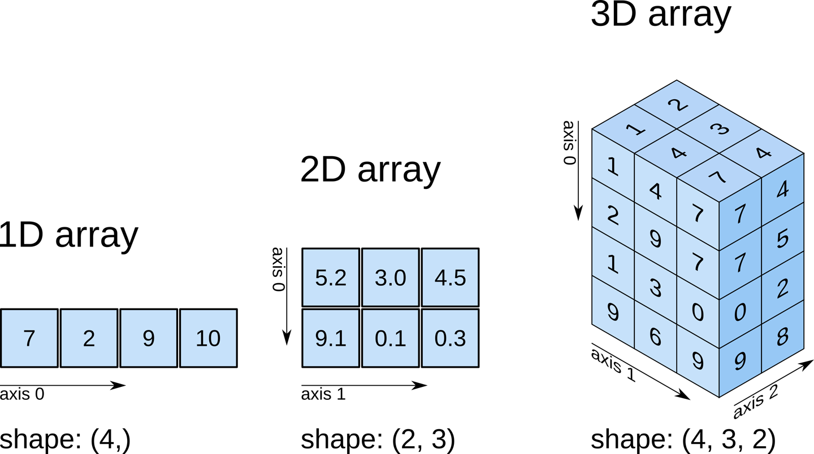
NumPy Multidimensional Arrays
Shape
1D: (length)
2D: (rows, columns)
3D: (rows, columns, depth)
...

Slide 16
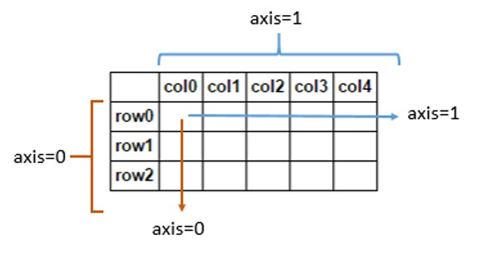
NumPy Multidimensional Arrays
Axis
Axis 0: rows (down the columns)
Axis 1: columns (across the rows)

Slide 17
NumPy Demo

